Slide 1
Multi level serial prediction patterns in the holdings record
Yoel Kortick
Senior Librarian

Slide 2
Agenda
Introduction
Our sample serial
Types of in the Community Zone
Opening the predicted items
Receiving and summary holdings creation
Summary

Slide 3
Introduction
The Alma serial prediction pattern resides in the holdings record and complies with full MARC standards.
The prediction pattern fields with which this presentation will deal are:
  853 - Captions and Pattern - Basic Bibliographic Unit
  854 - Captions and Pattern - Supplementary Material
  855 - Captions and Pattern - Indexes

Slide 4
Introduction
For details regarding how serial prediction patterns are used in Alma see presentation “Serials - Prediction Patterns and Serial Check-in.pptx” at https://knowledge.exlibrisgroup.com/@api/deki/files/51920/Serials_-_Prediction_Patterns_and_Serial_Check-in.pptx
See also other presentations at https://knowledge.exlibrisgroup.com/Alma/Training/Extended_Training/Presentations_and_Documents_-_Serials
This particular presentation here will focus exclusively on how one serials holdings record may have multi level prediction patterns, for example an 853, 854 and 855 field (or any combination thereof) all in one record.

Slide 5
Agenda
Introduction
Our sample serial
Creating the multi level serial prediction pattern
Opening the predicted items
Receiving and summary holdings creation
Summary

Slide 6

Our sample serial
Our sample serial is title
“WSQ: Women's studies quarterly”, ISSN 0732-1562

Slide 7
Our sample serial
This serial:
  Is a quarterly publication
  Includes an annual index
  Includes an annual supplement
Note: While in actuality this publication does not really have an annual index and an annual supplement we are “pretending it does” in order to show the Alma functionality of having this information in the prediction pattern.

Slide 8
Our sample serial
The quarterly publication will use the standard Alma cataloging template ‘serial prediction quarterly seasons’ which utilizes the 853 field
The annual index will use the standard Alma cataloging template ‘serial prediction annual index’ which utilizes the 854 field
The annual supplement will use the standard Alma cataloging template ‘serial prediction annual supplement’ which utilizes the 855 field

Slide 9
Agenda
Introduction
Our sample serial
Creating the multi level serial prediction pattern
Opening the predicted items
Receiving and summary holdings creation
Summary

Slide 10
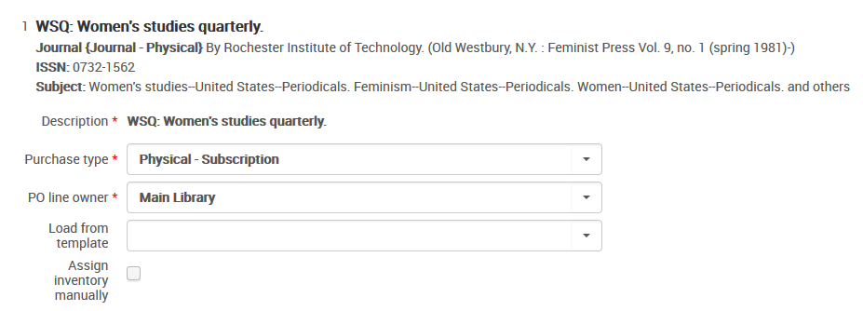
Creating the multi level serial prediction pattern
An order is created for the serial

Slide 11
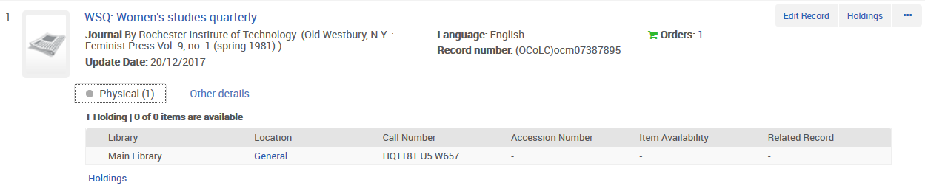
Creating the multi level serial prediction pattern
When the order was created a holdings record (with no items) was also created and now we will edit it

Slide 12
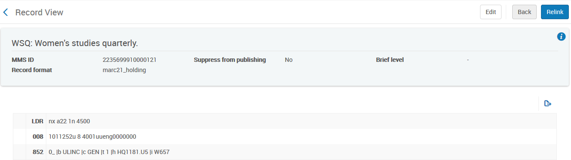
Creating the multi level serial prediction pattern
Now we will edit the holdings record and add multi level prediction pattern fields.

Slide 13
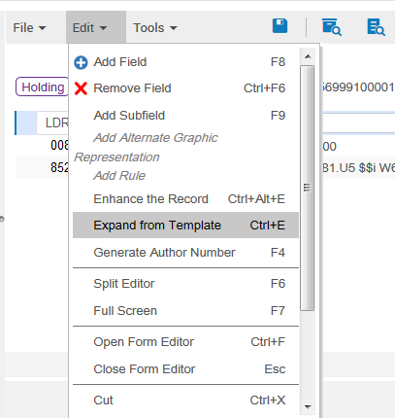
Creating the multi level serial prediction pattern
And via ‘Expand from template ‘ (ctrl+E) we will begin adding the 853, 854 and 855 fields.

Slide 14
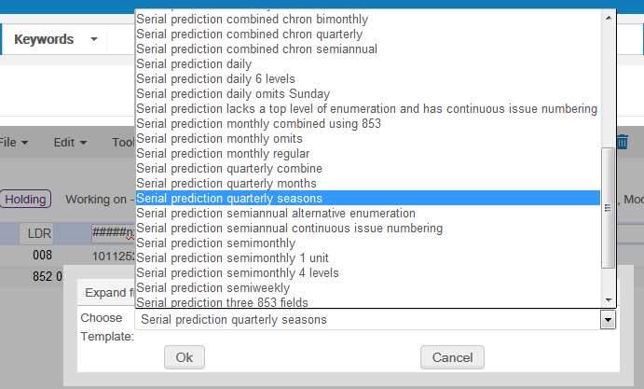
Creating the multi level serial prediction pattern
First we will choose quarterly seasons

Slide 15
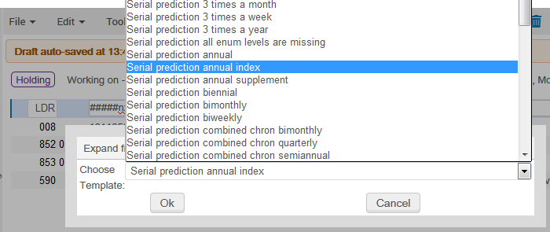
Creating the multi level serial prediction pattern
Then we will choose annual index

Slide 16
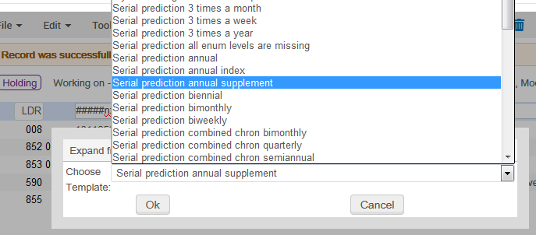
Creating the multi level serial prediction pattern
And then we will choose annual supplement

Slide 17
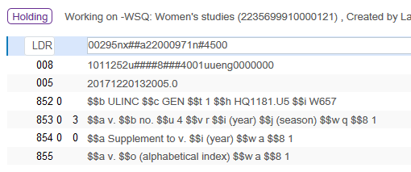
Creating the multi level serial prediction pattern
And now we have this holdings record, which of course can be edited as desired instead of taking the template fields ‘as is’.
853 Quarterly issues
854 Supplement
855 Index

Slide 18
Creating the multi level serial prediction pattern
These are the “Captions and pattern” fields in the holdings record
85303 | $$a v. $$b no. $$u 4 $$v r $$i (year) $$j (season) $$w q $$8 1
85400 | $$a Supplement to v. $$i (year) $$w a $$8 1
855 | $$a v. $$o (alphabetical index) $$w a $$8 1

Slide 19
Creating the multi level serial prediction pattern
With field 85303, then 85400 and then 855 selected the staff user chooses either:
Menu ‘Tools > Marc 21 Holdings > Next predicted item’s information ‘
Does shortcut key F3

Slide 20
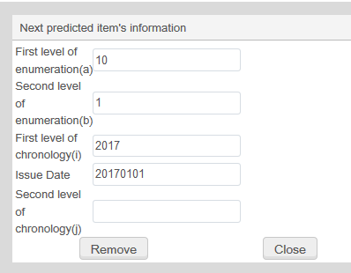
Creating the multi level serial prediction pattern
For field 85303 we will fill in as follows:
First level of enumeration(a) = 10
Second level of enumeration(b) = 1
First level of chronology(i) = 2017
Issue Date = 20170101

Slide 21
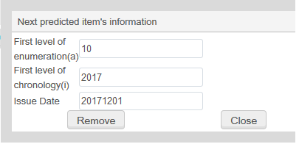
Creating the multi level serial prediction pattern
For field 85400 we will fill in as follows:
First level of enumeration(a) = 10
First level of chronology(i) = 2017
Issue Date = 20171201

Slide 22
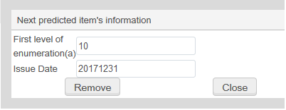
Creating the multi level serial prediction pattern
For field 855 we will fill in as follows:
First level of enumeration(a) = 10
Issue Date = 20171231

Slide 23
Agenda
Introduction
Our sample serial
Creating the multi level serial prediction pattern
Opening the predicted items
Receiving and summary holdings creation
Summary

Slide 24
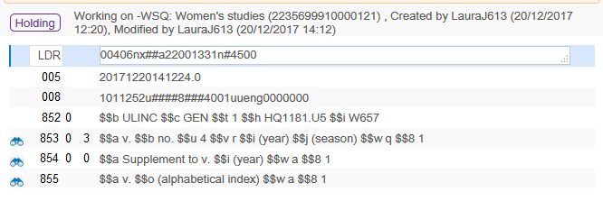
Opening the predicted items
Now all three fields are linked to a ‘Next predicted item’s information’.

Slide 25
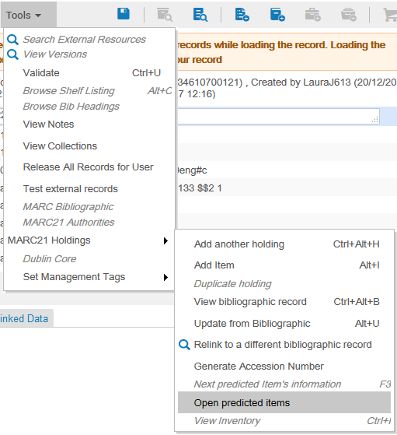
Opening the predicted items
We can open the items from the metadata editor holdings record doing Menu ‘Tools > Marc 21 Holdings > Open predicted items’

Slide 26
Opening the predicted items
The user is presented with the items as they will appear and if he ‘approves’ (does not want to first change the ‘Next predicted item’s information and try again) then he can click ‘save’.
Note that in our case the expected arrival date will be 10 days after the publication date because in the related POL we have ‘subscription interval’ = ‘10’

Slide 27
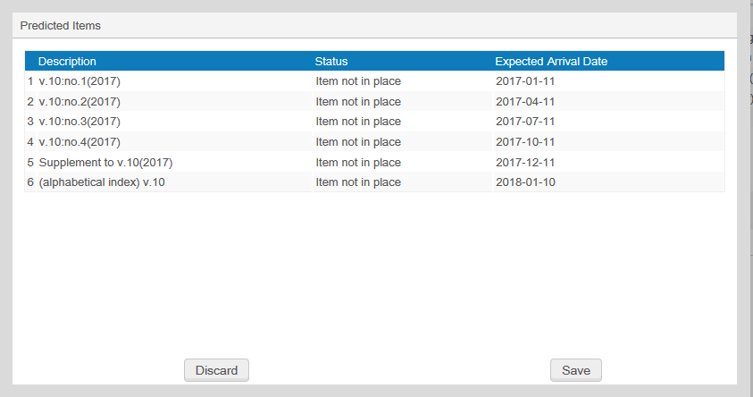
Opening the predicted items
853 Quarterly issues
855 Index
854 Supplement
We will click ‘Save’

Slide 28
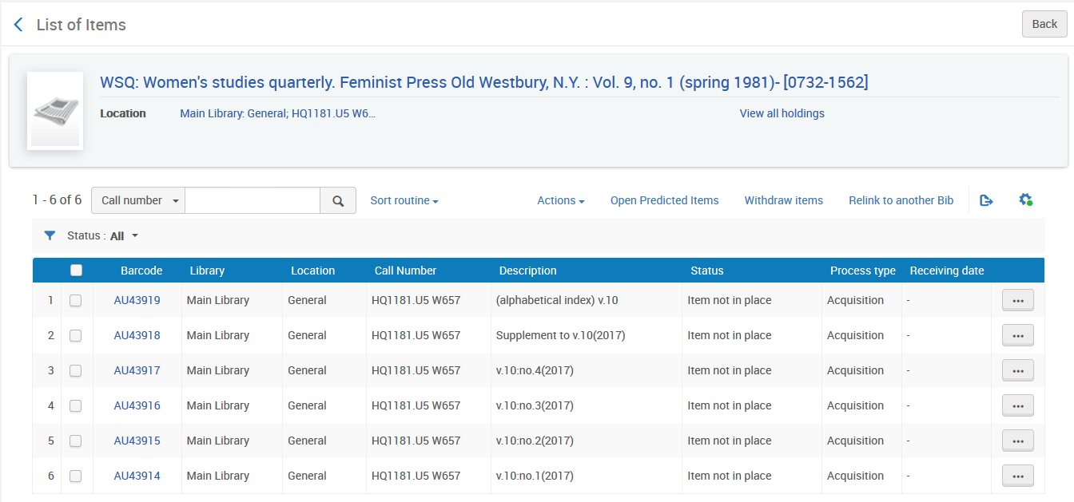
Opening the predicted items
The items have been created

Slide 29
Opening the predicted items
Note that from the items list (and not only from the holdings record) we can open the next cycle of predicted items
We will open next cycle of predicted items from here

Slide 30
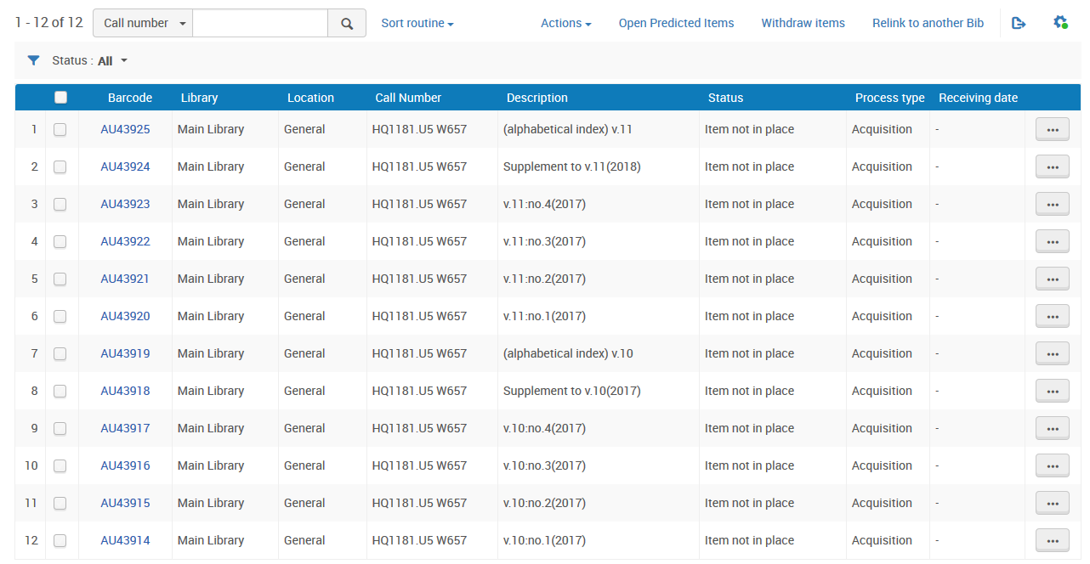
Opening the predicted items
Now we have two cycles open
Volume 11
Volume 10

Slide 31
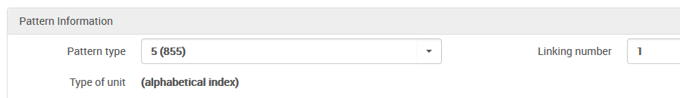

Opening the predicted items
Note that each item is linked to a specific 85X field
This is the “pattern information” in the enum/chron information tab of the item which is alphabetical index.

Slide 32
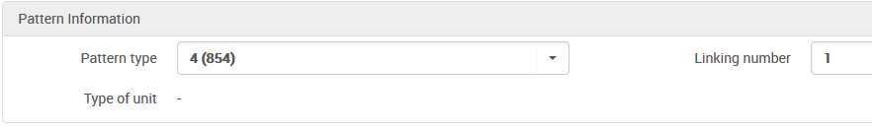
Opening the predicted items
Note that each item is linked to a specific 85X field
This is the “pattern information” in the enum/chron information tab of the item which is a supplement.

Slide 33
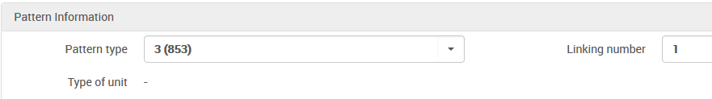
Opening the predicted items
Note that each item is linked to a specific 85X field
This is the “pattern information” in the enum/chron information tab of the item which is a basic unit.

Slide 34
Agenda
Introduction
Our sample serial
Creating the multi level serial prediction pattern
Opening the predicted items
Receiving and summary holdings creation
Summary

Slide 35
Receiving and summary holdings creation
Alma allows for the automatic creation of holding summary fields.
This includes
The 863-865 Enumeration and Chronology fields
The 866-868 Textual Holdings fields
For details see presentation “Serials - Automation tasks for summary holdings.pptx” at https://knowledge.exlibrisgroup.com/@api/deki/files/51922/Serials_-_Automation_tasks_for_summary_holdings.pptx

Slide 36
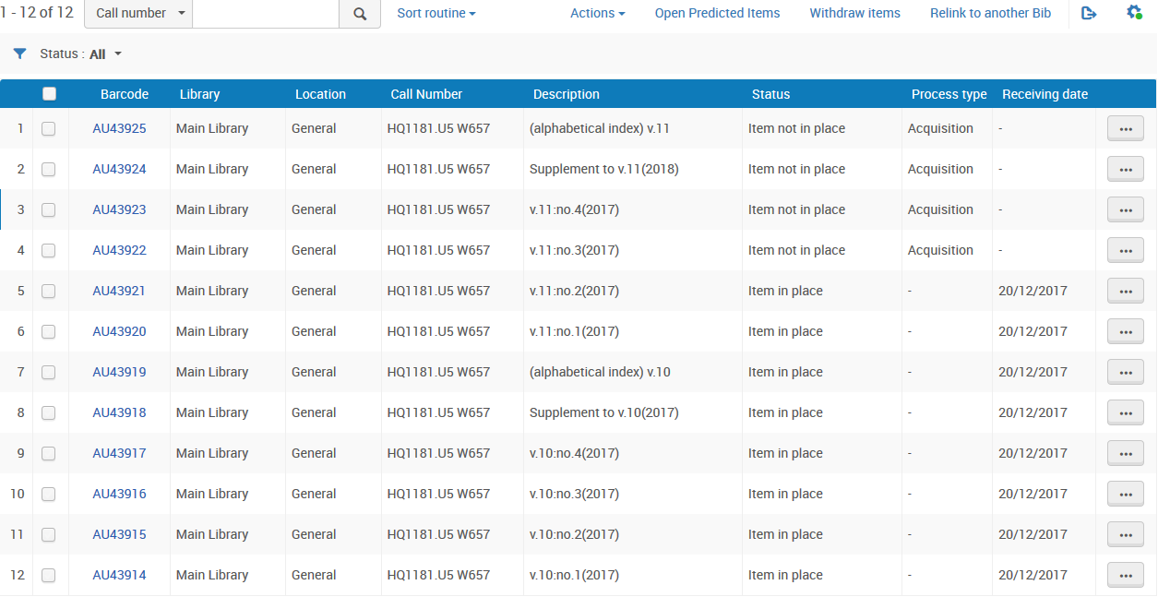
Receiving and summary holdings creation
In our example: At this time all of volume 10 arrived, and from volume 11 issues 1 and 2 arrived.

Slide 37
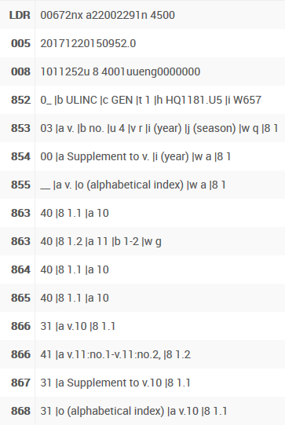
Receiving and summary holdings creation
The holdings record is updated with summary holdings fields when saved
863 Enumeration and Chronology - Basic Bibliographic Unit
864 Enumeration and Chronology - Supplementary Material
865 Enumeration and Chronology - Indexes
866 Textual Holdings - Basic Bibliographic Unit
867 Textual Holdings - Supplementary Material
868 Textual Holdings - Indexes

Slide 38
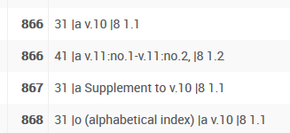
Receiving and summary holdings creation
The holdings record is updated with summary holdings fields when saved
This means that all of vol. 10 has arrived, and from volume 11 issues 1 and 2 have arrived.
This means that the supplement to volume 10 has arrived
This means that the index to volume 10 has arrived

Slide 39

Receiving and summary holdings creation
The summary holdings field can be configured to display in the Primo GetIt tab
This can aid the user in immediately identifying what is available in the library without needing to scroll though a list of items.

Slide 40
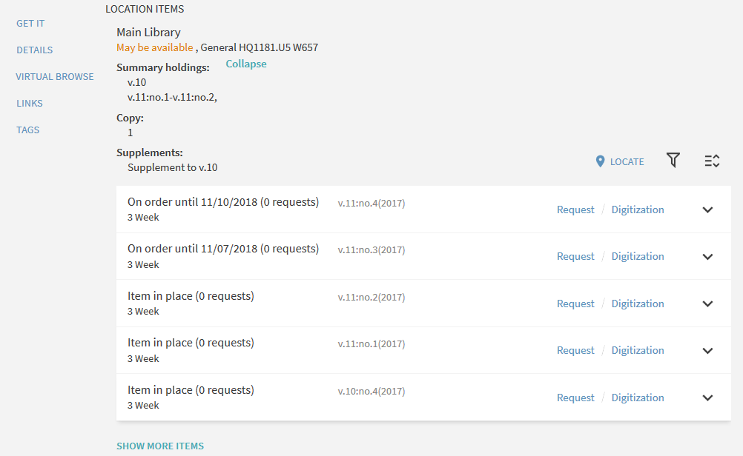
Receiving and summary holdings creation
The summary holdings field can be configured to display in the Primo GetIt tab
Coming from holdings 866 field
Coming from holdings 867 field

Slide 41
Agenda
Introduction
Our sample serial
Creating the multi level serial prediction pattern
Opening the predicted items
Receiving and summary holdings creation
Summary

Slide 42
Summary
One Alma Holdings record can contain multiple predication pattern fields on multiple levels including:
  853 - Captions and Pattern - Basic Bibliographic Unit
  854 - Captions and Pattern - Supplementary Material
  855 - Captions and Pattern - Indexes

Slide 43
Summary
The prediction pattern fields can easily be added to the holdings record by the cataloger using one of a variety of predefined templates.
After adding the prediction pattern fields from the template they can be edited if desired.
The relevant enumeration and chronology of each of the prediction pattern fields can easily be added via a user friendly form in the metadata editor.

Slide 44
Summary
The predicted items can be opened (created) either from within the metadata editor or from within the list of items.
Summary holdings information is automatically added to the holdings record using normalization routines and processes.
The summary holdings fields can appear in Primo thereby aiding the end user.

Slide 45
Thank You

